Slide 1
R package {cor2Venn}
Visualizing correlation matrices as Venn diagrams
https://github.com/mhsteppan/cor2venn
Martin Steppan

Slide 2
Background
I always wanted to have a tool like this
There is no such tool available
with more than 2 variables there is usually no perfect fit in 2D
Optimization required (like in SEM)
Visualization tools get a lot of citations, e.g. „semPlot“ (Epskamp, 2018)
Methodologically challenging how to make the optimization computationally fast

Slide 3
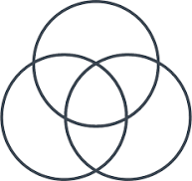
Introduction
The package visualizes a correlation matrix as a Venn diagram
The overlap of circles represents the shared variance (R squared) between variables
Using additional features (e.g. «cor2dist») the distance between variables is proportionate to their correlation
close = positive correlation
distant = negative correlation
The problem is optimized using Quasi-Newton optimization
Computationally heavy
Computation time increases exponentially the more variables are included
Installation in R:
library(devtools)
install_github("mhsteppan/cor2Venn")

Slide 4
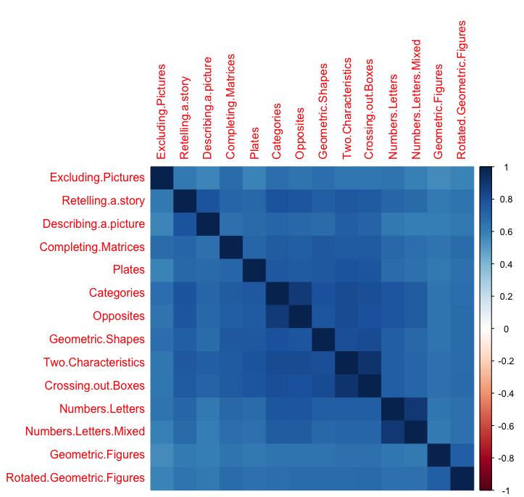
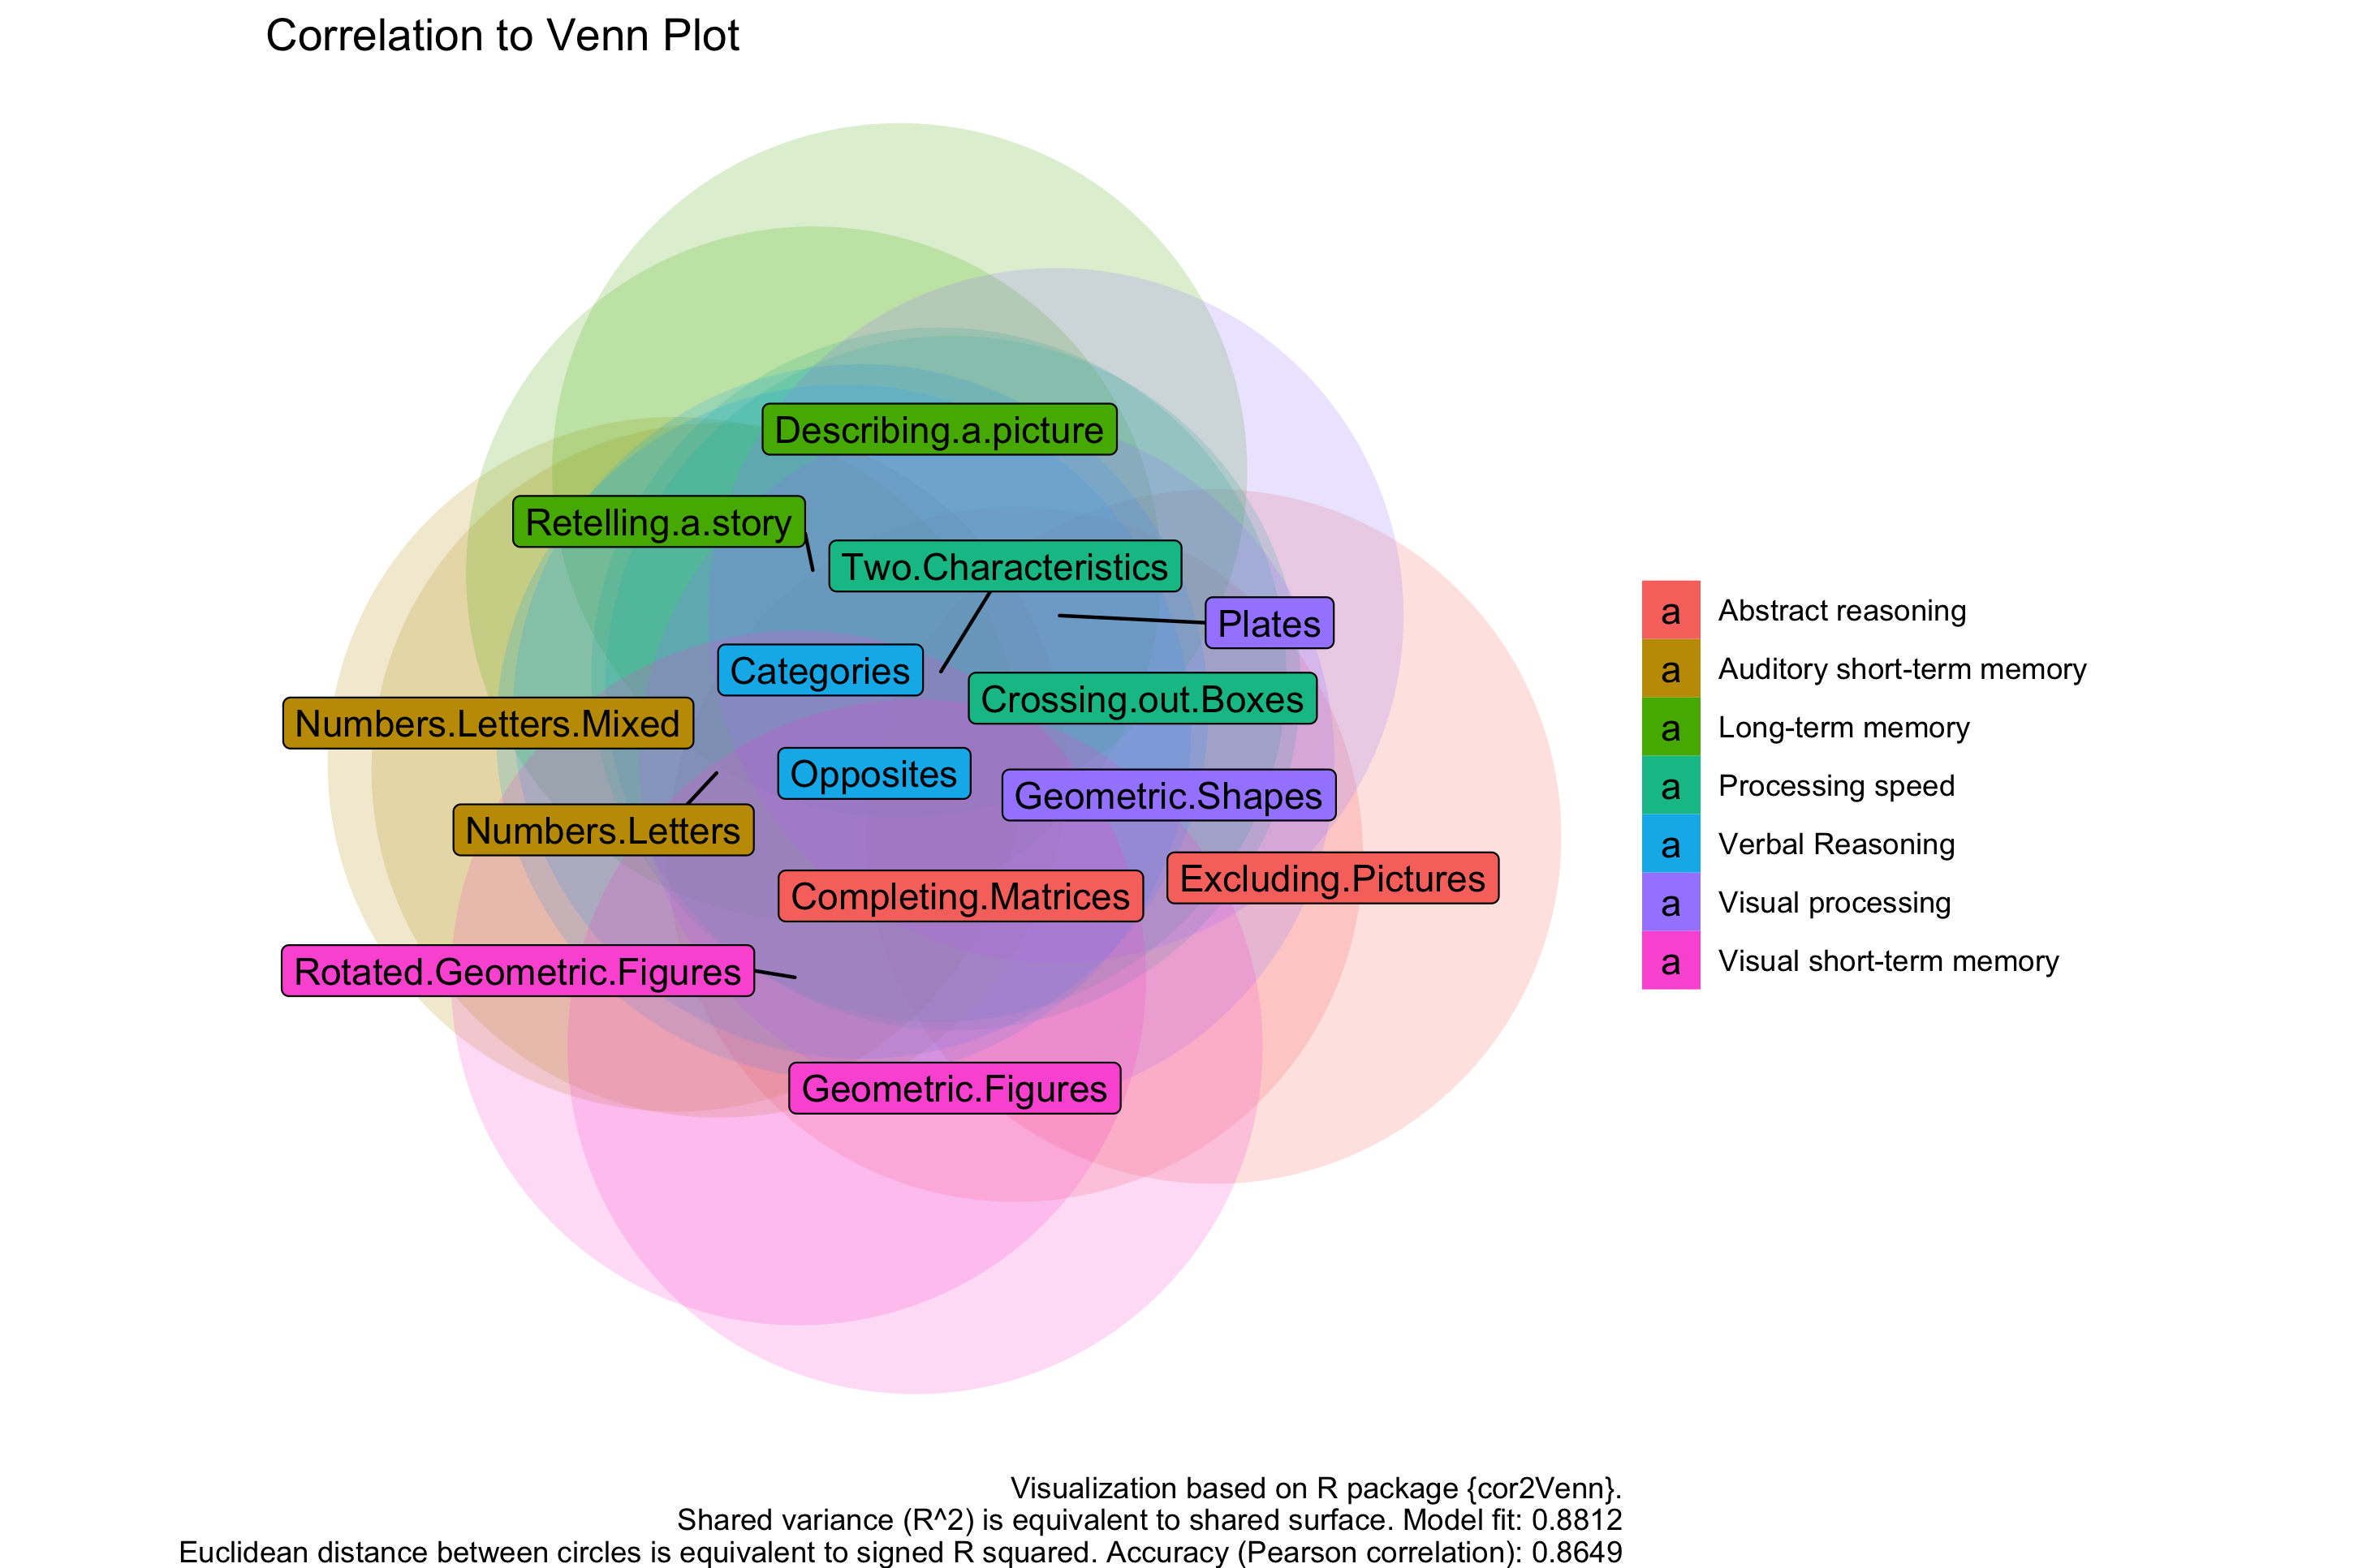
Results 1: Positive manifold – the g‘ factor Example IDS-2

Slide 5
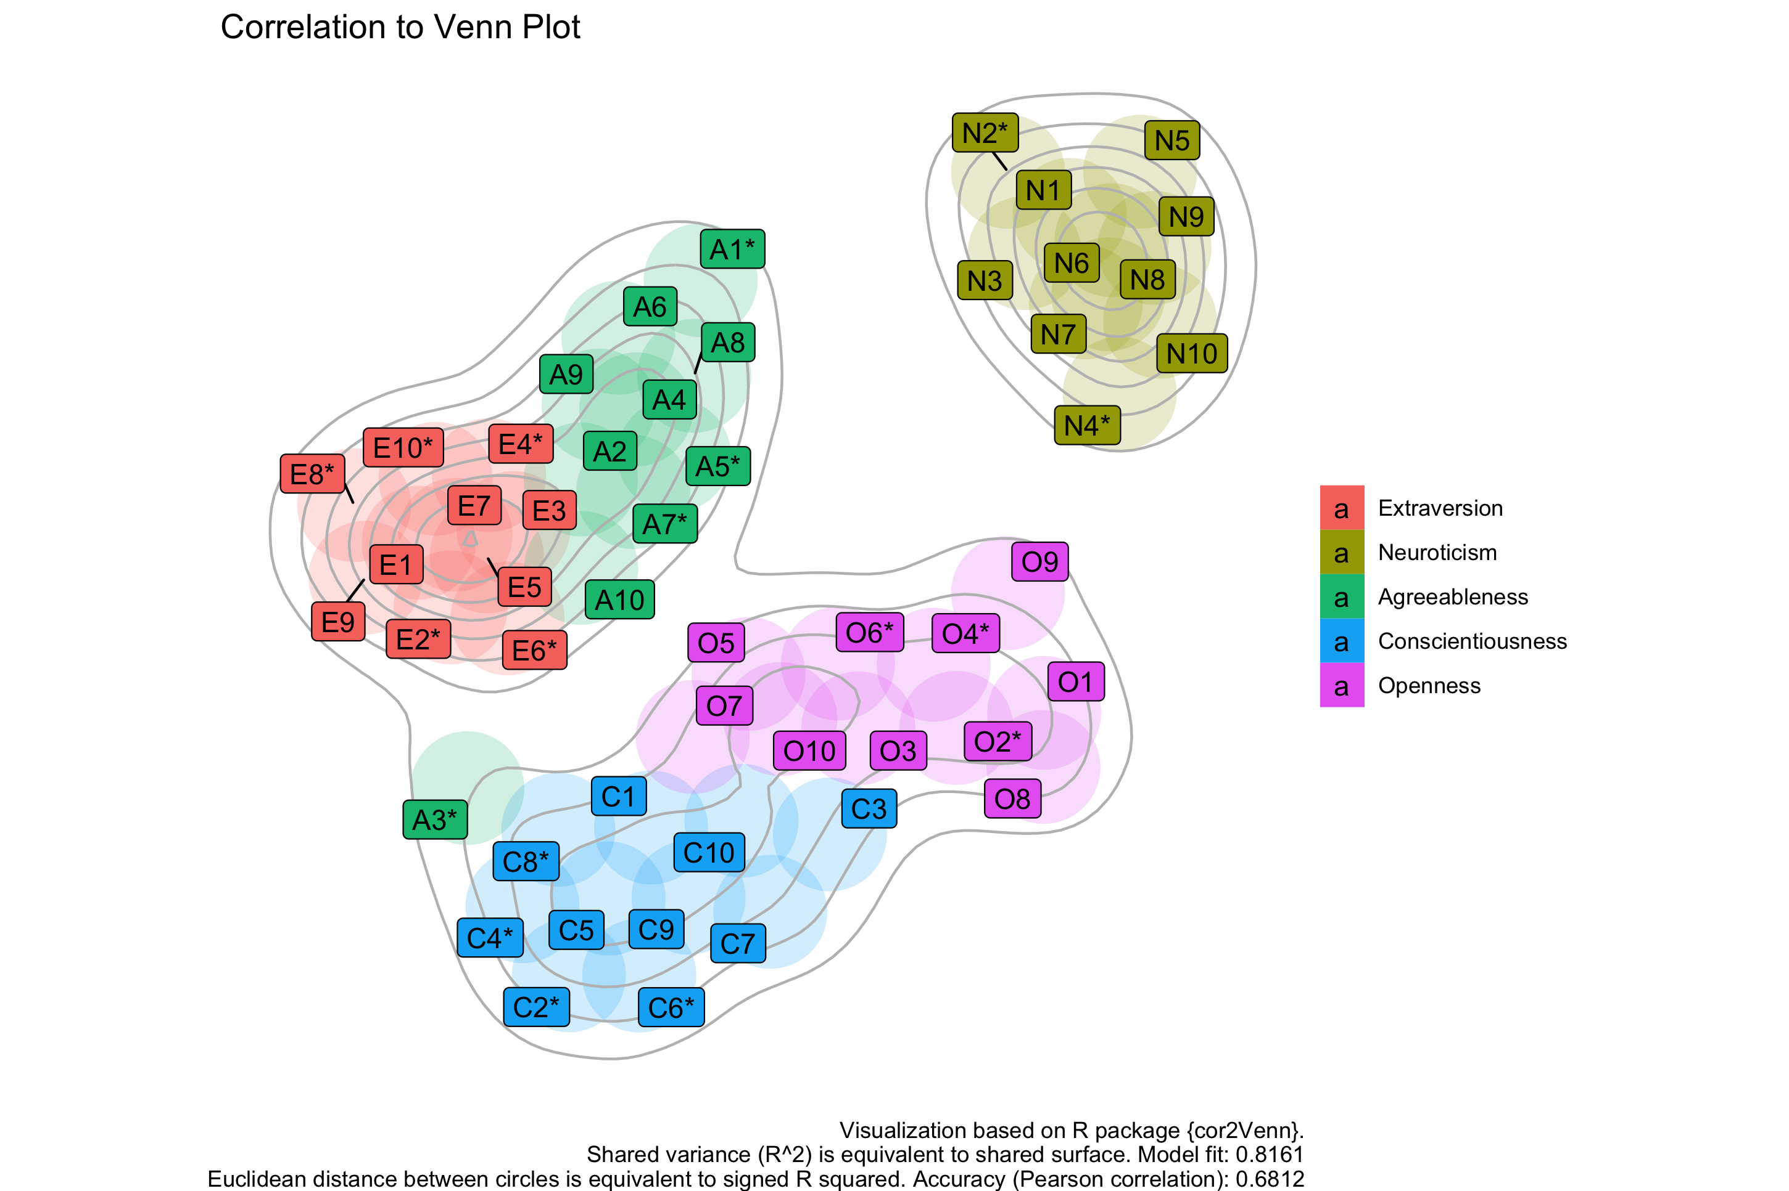
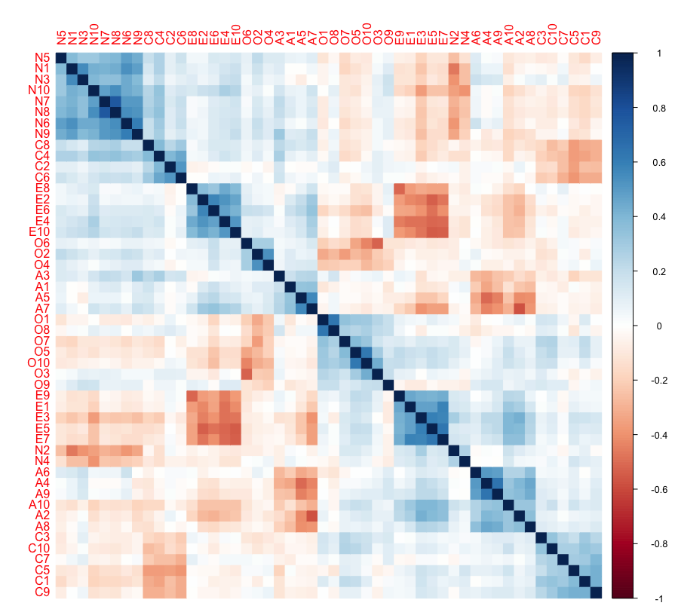
Results 2: Big Five Example: Openpsychometrics.org

Slide 6
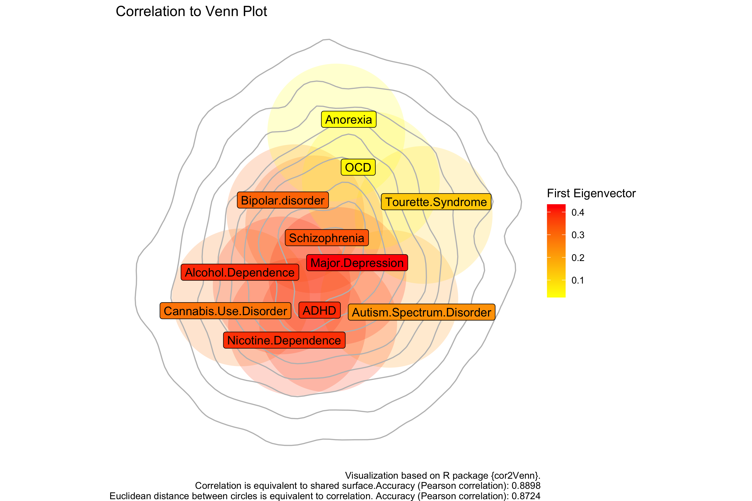
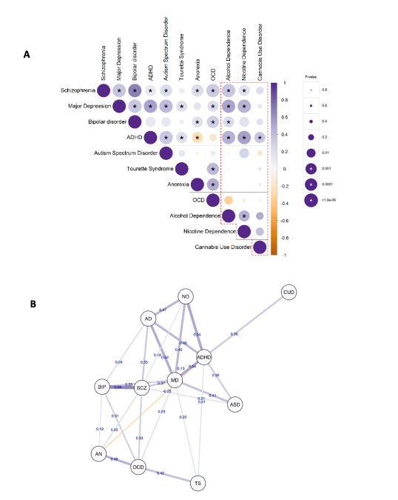
Results 3: The p‘ factor – genetic correlations Example: Abdellaoui et al. (2020)

Slide 7
Discussion
Strengths:
Tool is useful for making a correlation matrix more tangible and more easy to read
Useful for
psychometric research
exploratory data analysis
Hypothesis generation
Conference presentations
Limitations:
Reductionist / loss of information: it is not a perfect representation of the data -> similar to a SEM -> model fit indices
it is a „visual model“ (a simplification) of a correlation matrix

